Slide 1
Variational Autoencoders vs Generative Adversarial Networks
Dr. Víctor Uc Cetina
victoruccetina@gmail.com

Slide 2
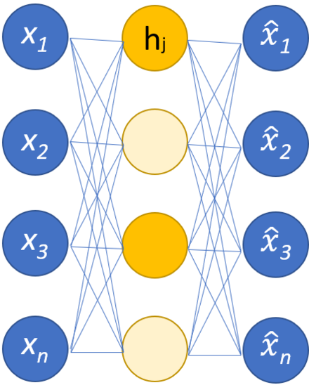
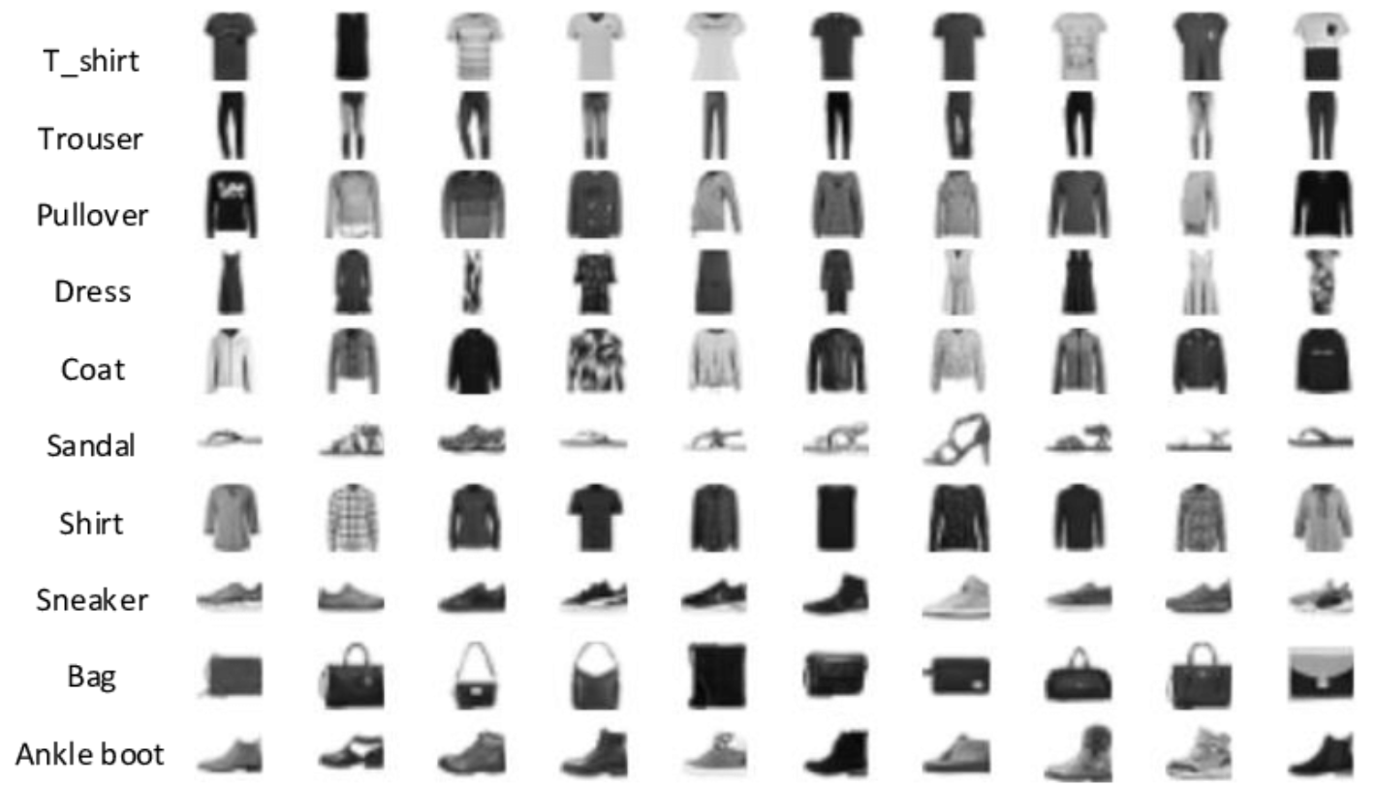
Content
Variational autoencoders (VAE’s)
Generative adversarial networks (GAN’s)
Autoencoder
mnist fashion

Slide 3
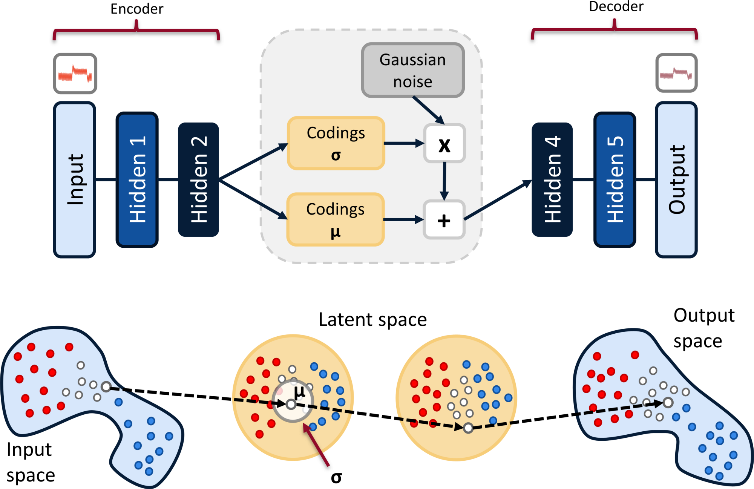
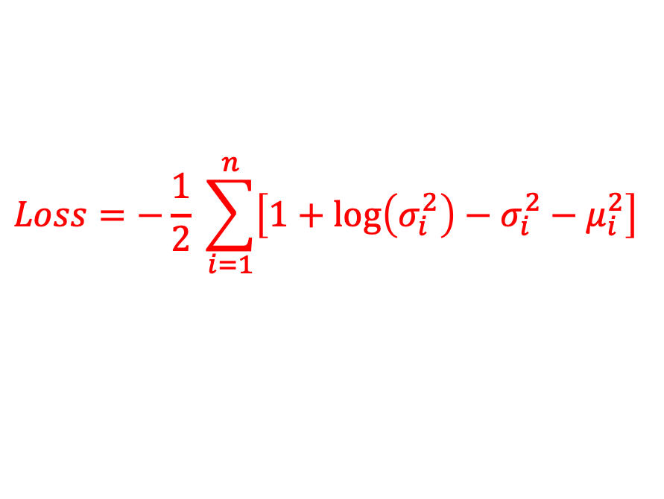

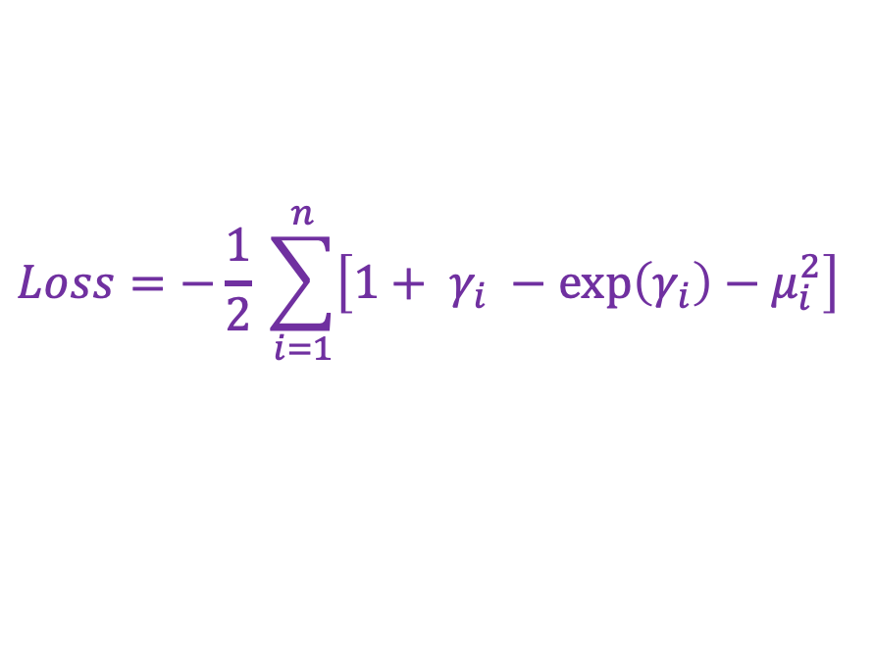
Variational Autoencoder
$$Loss=−\frac{1}{2} \sum_{i=1}^{n}{\left[1+\log\left(σ_{i}^{2}\right)−σ_{i}^{2}−μ_{i}^{2}\right]}$$
$$γ=\log{σ^{2}}$$
$$Loss=−\frac{1}{2} \sum_{i=1}^{n}{\left[1+ γ_{i} −\exp\left(γ_{i}\right)−μ_{i}^{2}\right]}$$

Slide 4
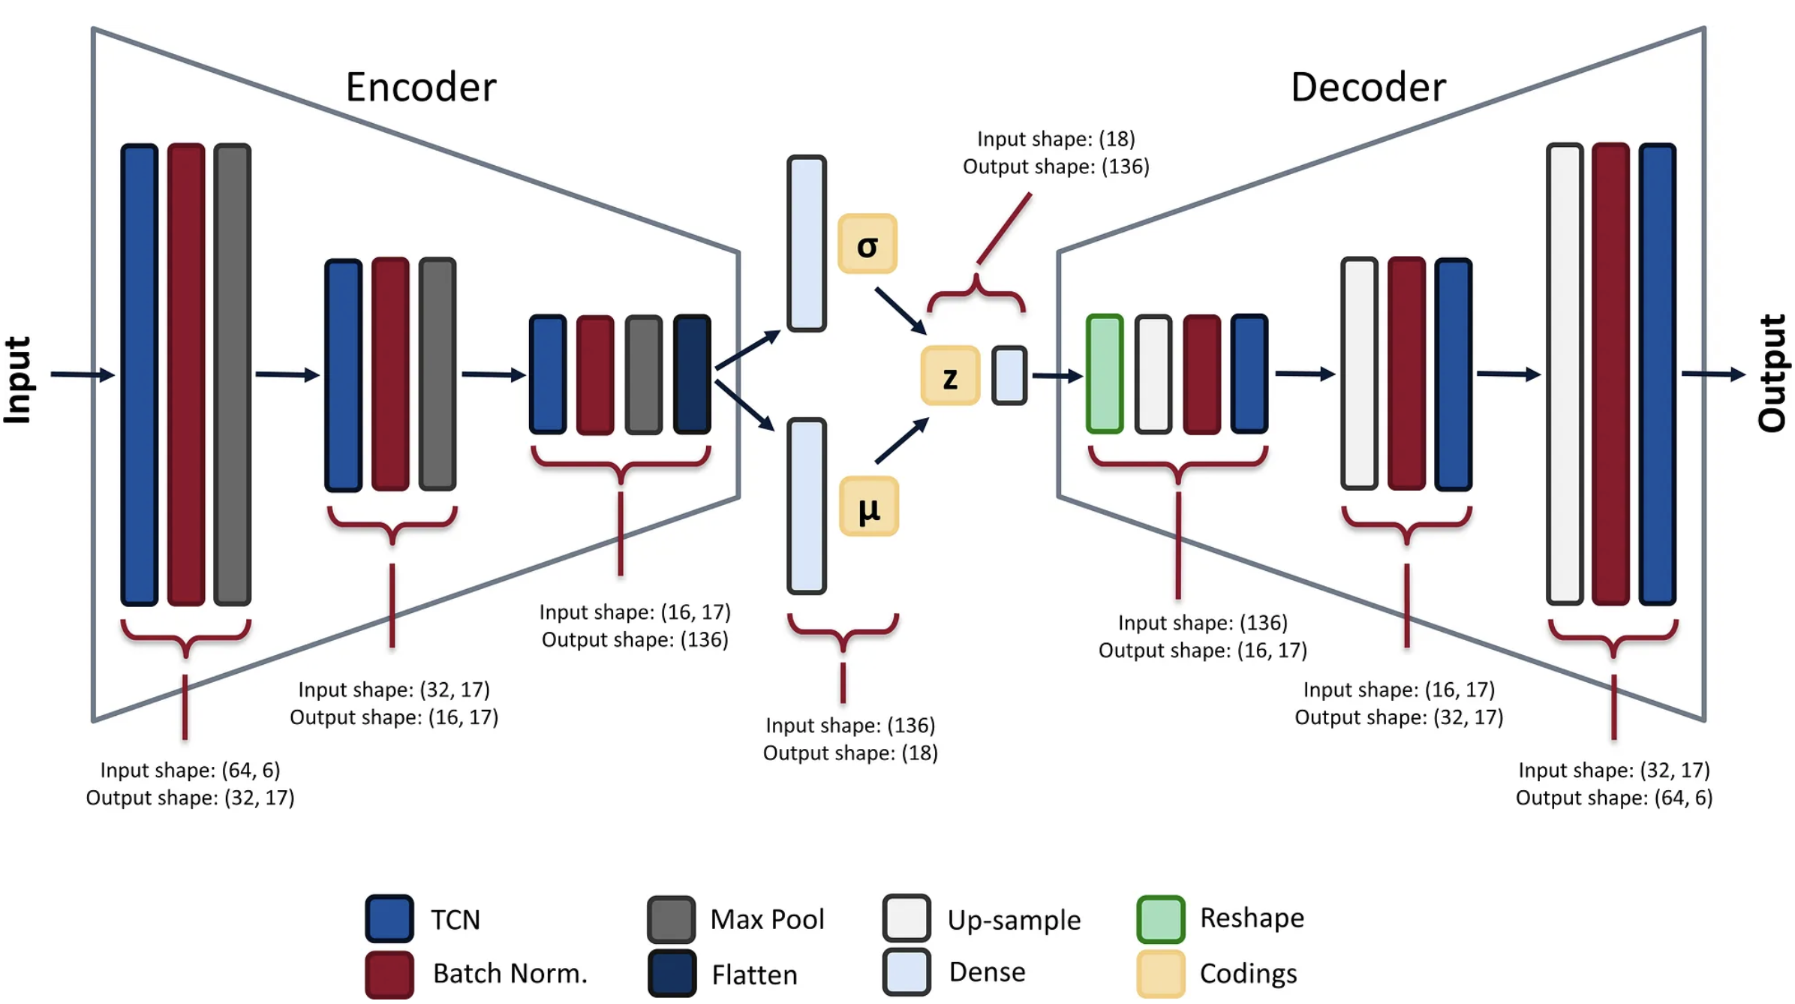
Anomaly detection using VAE
Anomaly Detection in Manufacturing, Part 2: Building a Variational Autoencoder
https://towardsdatascience.com/anomaly-detection-in-manufacturing-part-2-building-a-variational-autoencoder-248abce07349

Slide 5
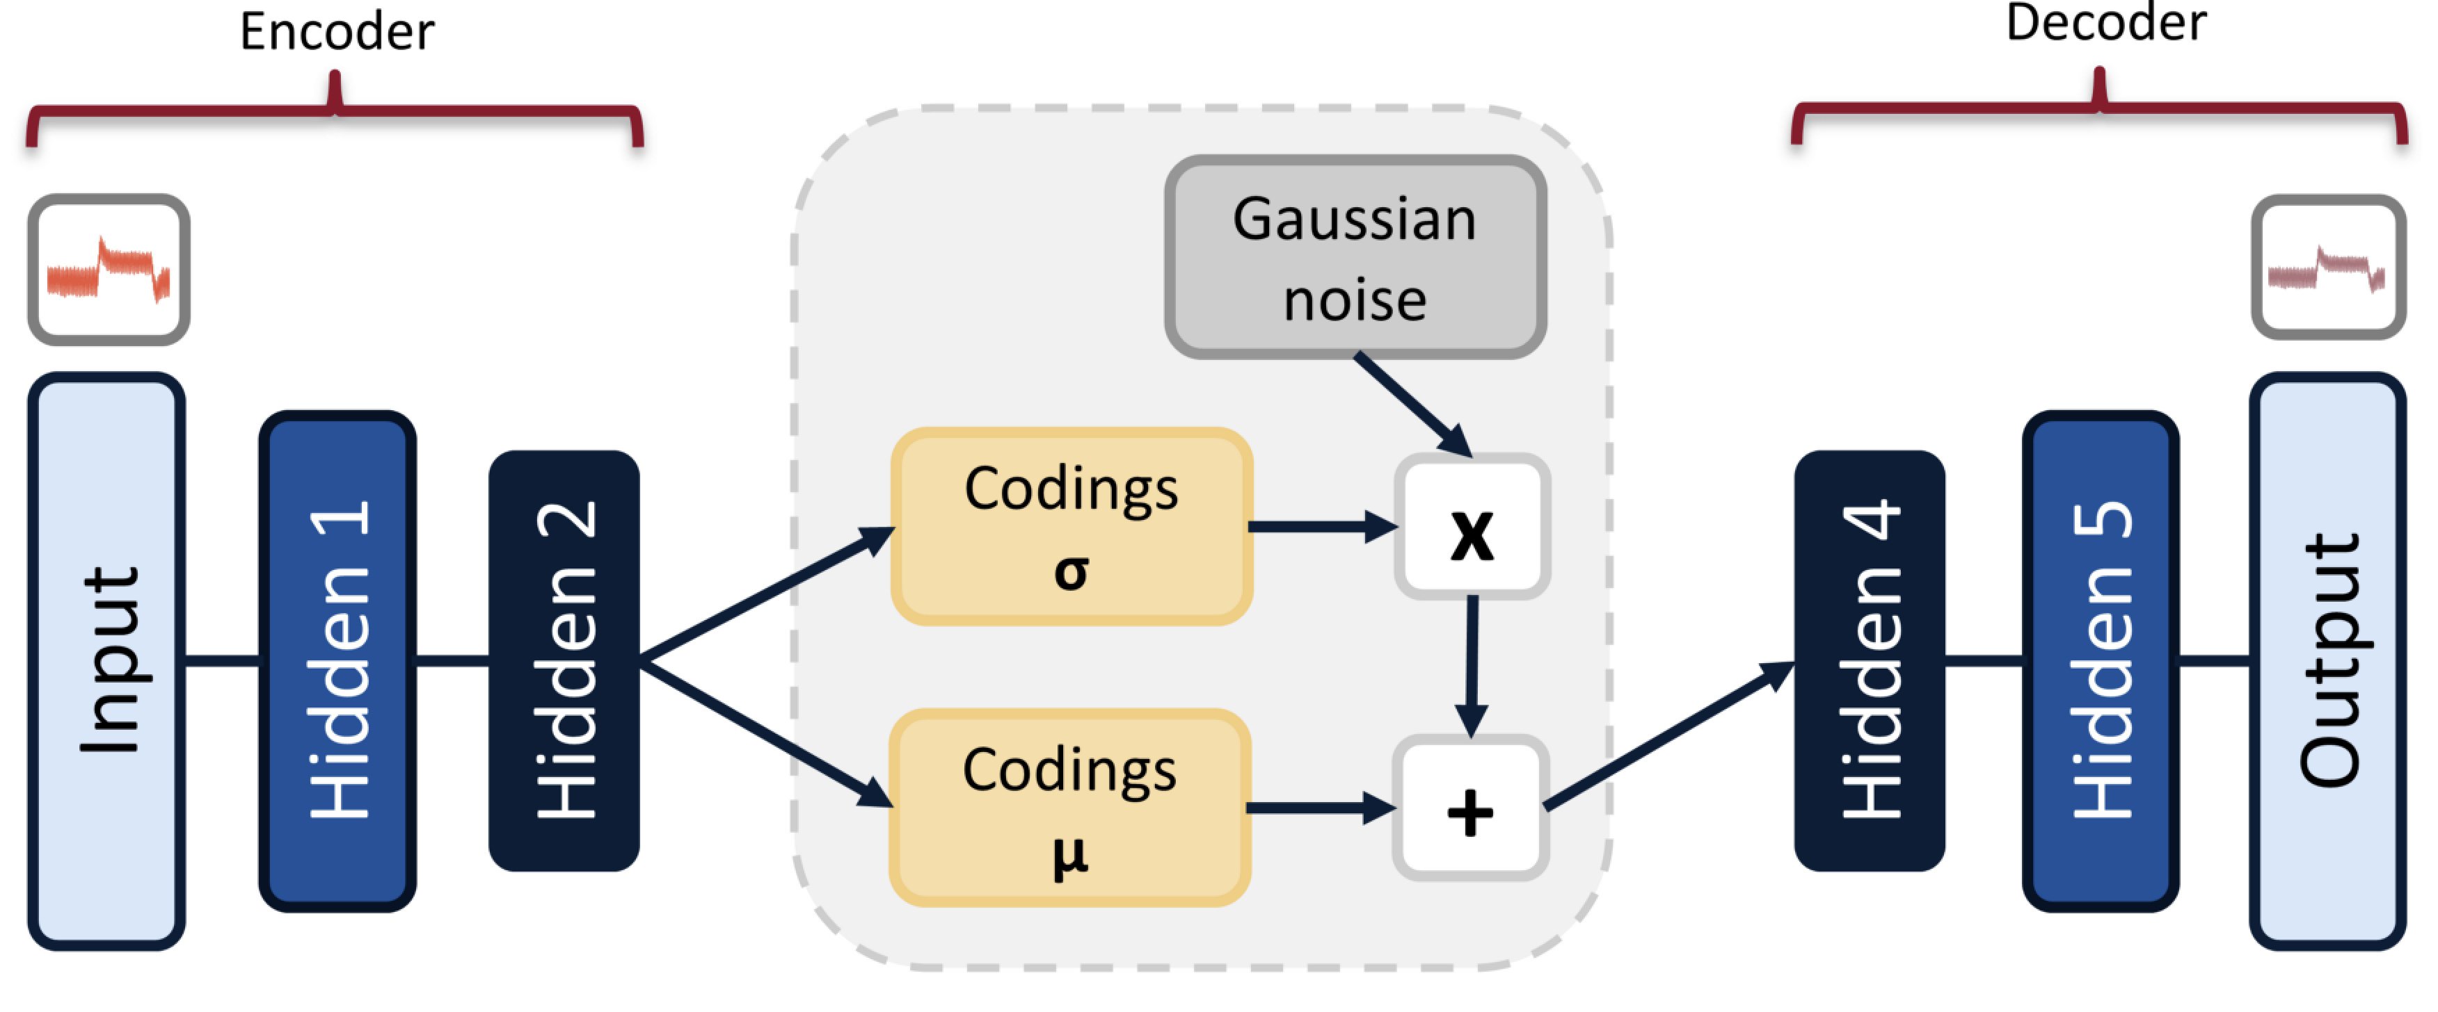
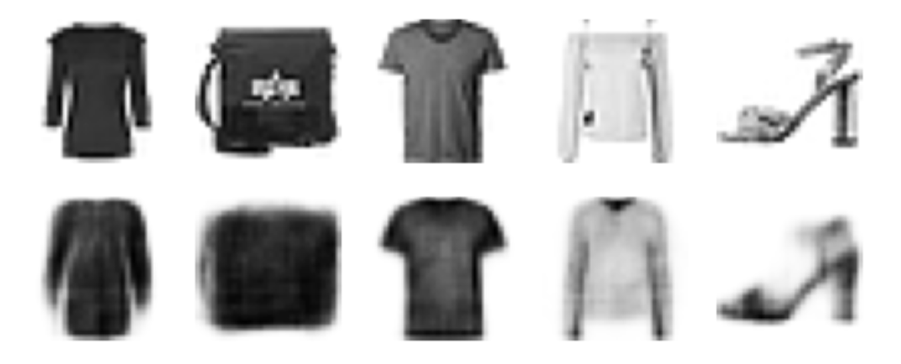
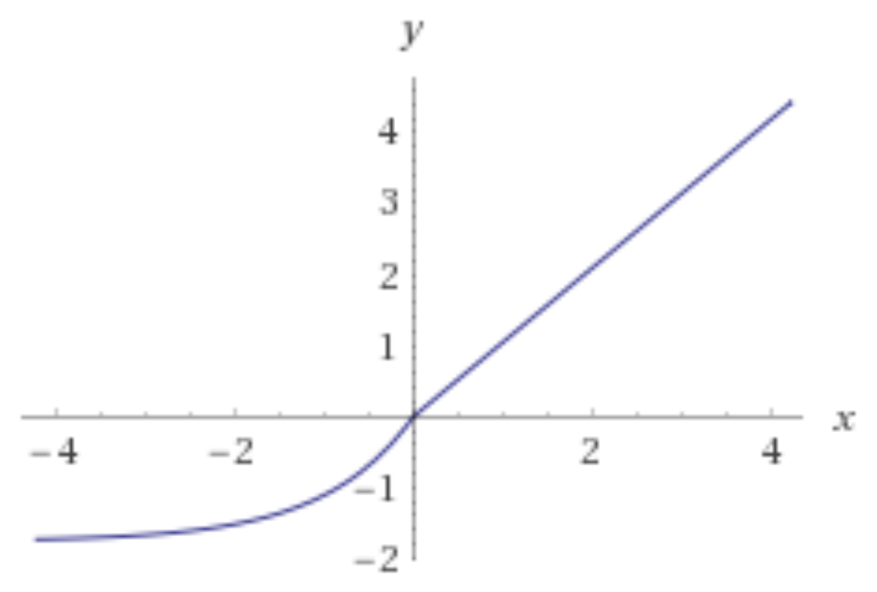
Variational Autoencoder
Reconstruction
Activation Function: SeLu

Slide 6
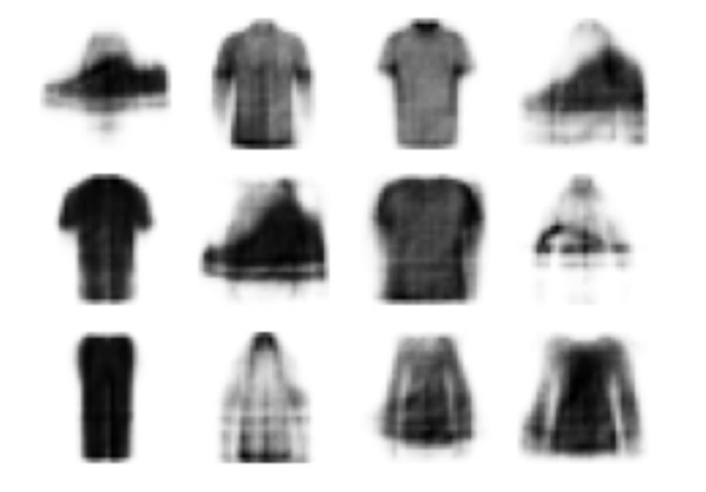
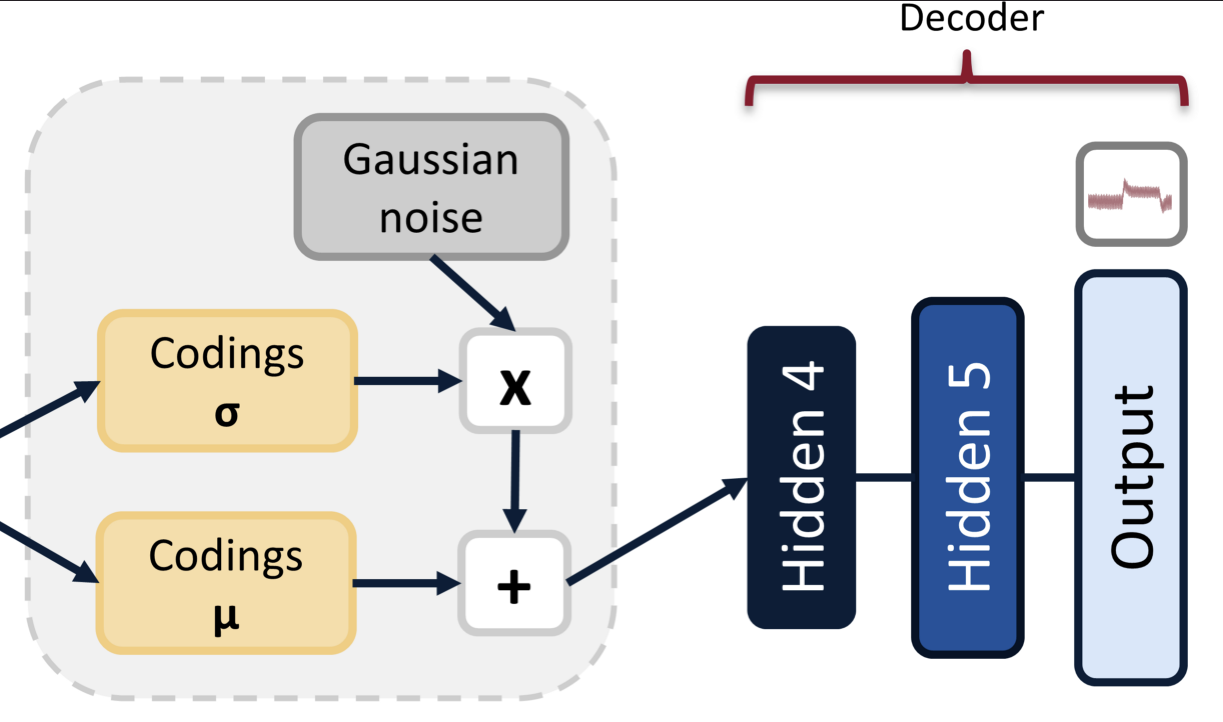
Variational Autoencoder

Slide 7
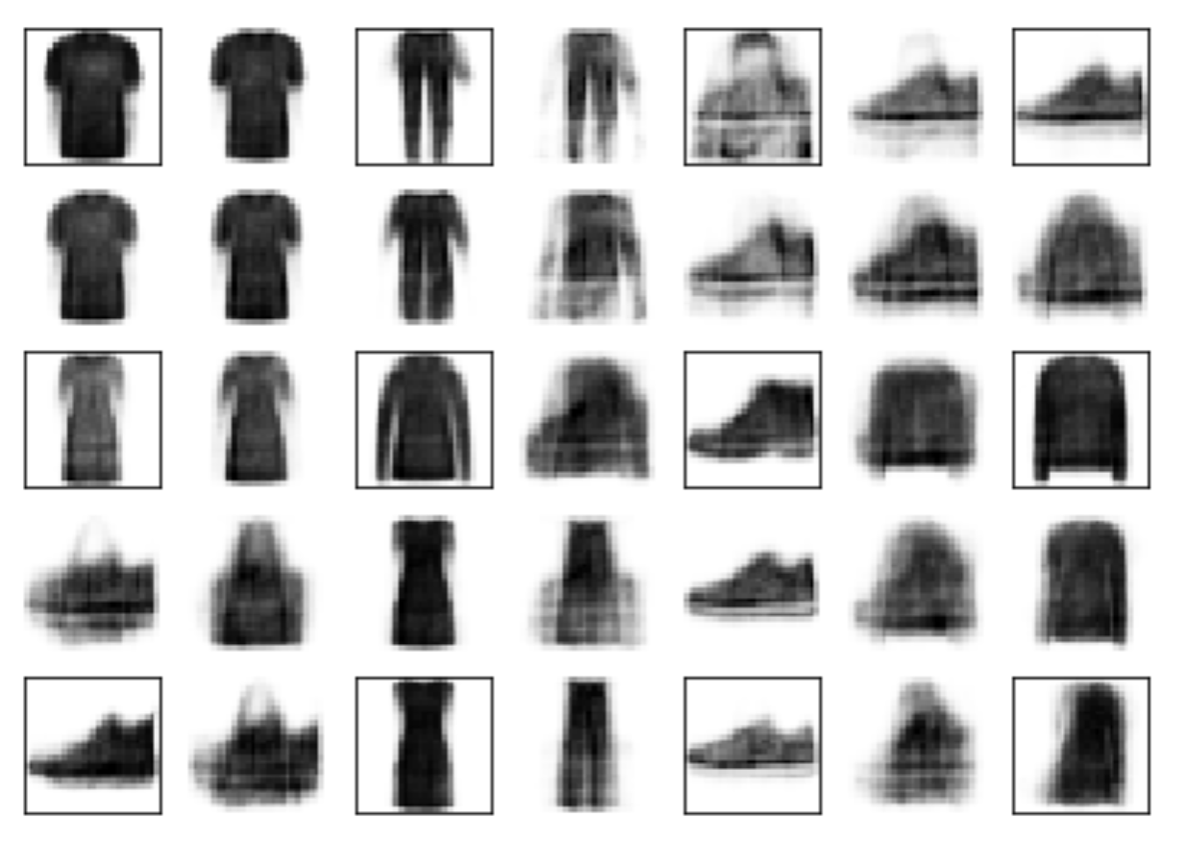
Variational Autoencoder
Semantic
Interpolation

Slide 8
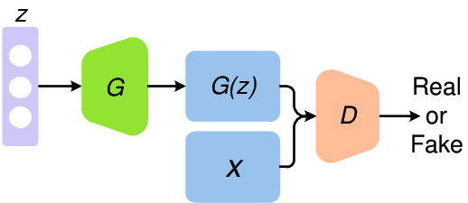
Generative Adversarial Network
Two training phases:
We train the discriminator with a batch of fake and real images.
We train the generator with fake images generated by itself, but labeled as real ones, in order to get an error from the discriminator.

Slide 9
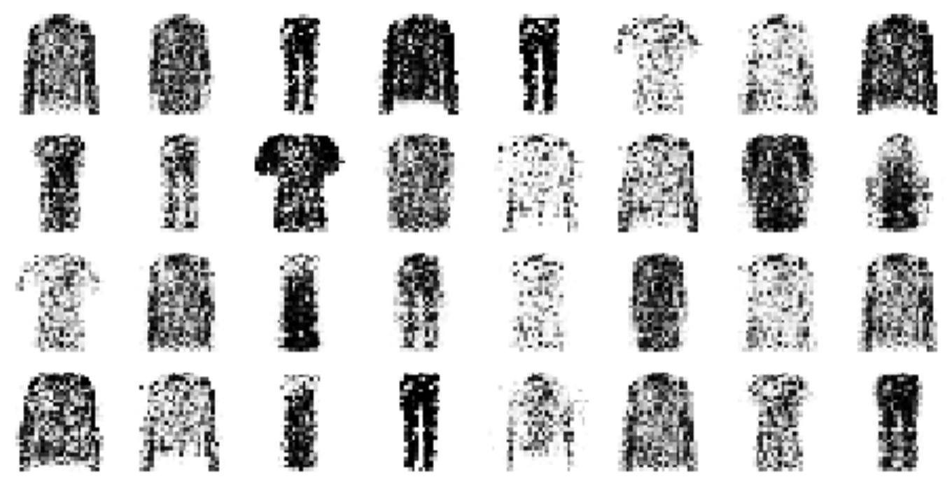
Generative Adversarial Network

Slide 10
Thank you!

